Slide 1
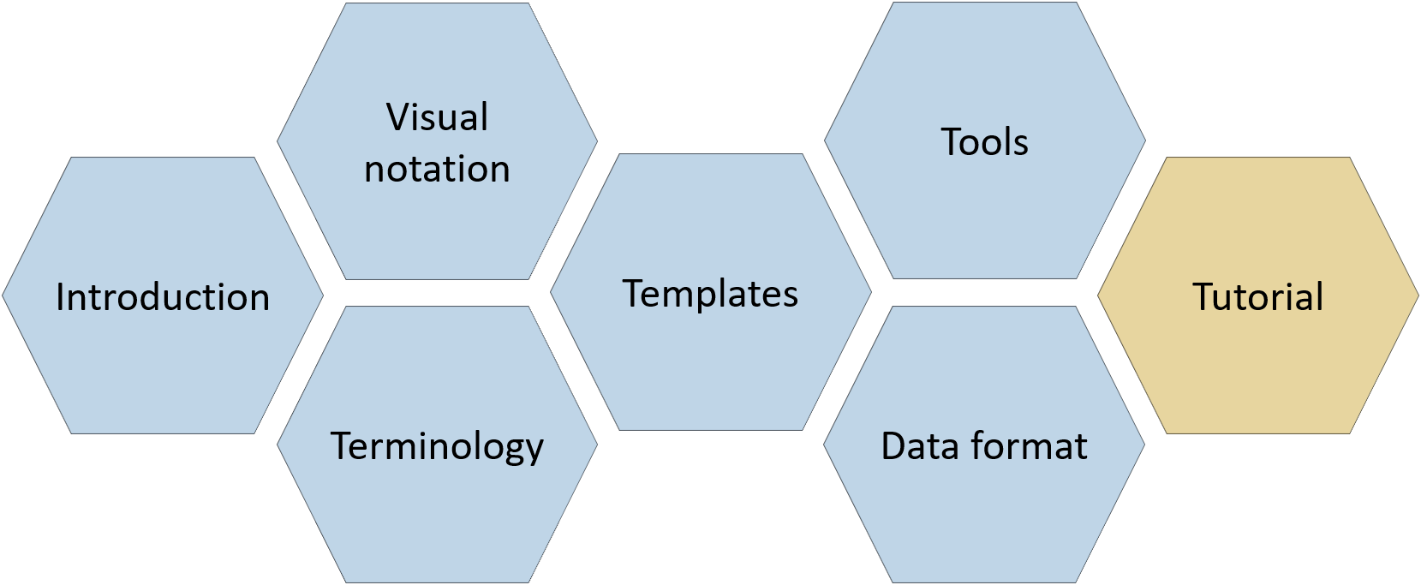
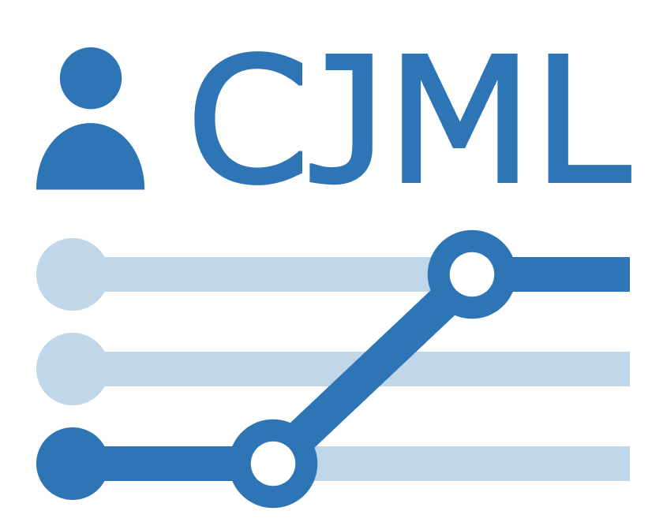
Tutorial
CJML – Customer Journey Modeling Language
Version 3.0 • June 2026
SINTEF Digital | Human-Computer Interaction Research Group

Slide 2
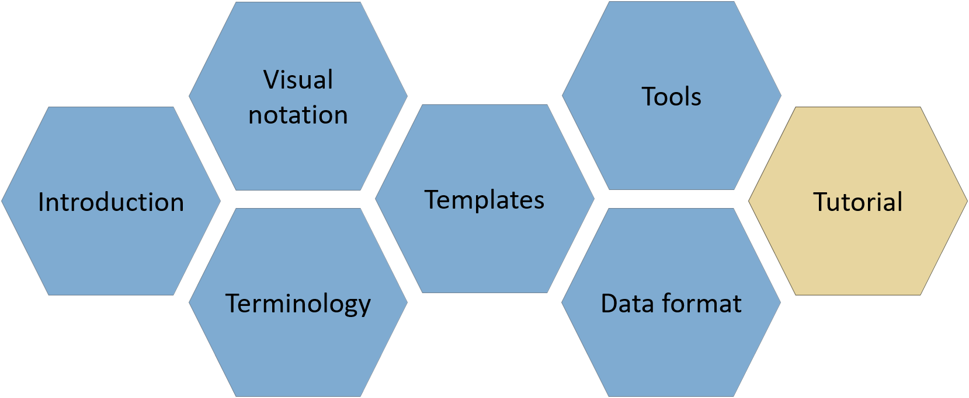

About
CJML consists of several modules, each covering a different aspect of the language. All resources are available at www.cjml.no
Diagram types, symbol gallery, visual features, and examples
Tools for creating and working with journeys
Overview of CJML, its conceptual foundation, and a quick tour of the visual notation
Guidance on journey thinking, journey data, approaches to analysis, and use cases
Definitions, metamodel, class diagrams, and model attributes
Machine-readable model structure, XML format, and data exchange
PowerPoint templates for quick, flexible diagramming with examples
Contact us: For questions or feedback, contact us at CJML<at>sintef.no
CJML v3 was developed as part of the research project Smart Journey Mining, funded by the Research Council of Norway (grant no. 312198).
How you may use this material: © SINTEF, licensed under
CC BY-SA 4.0. You may use, share, and adapt it with attribution, with adaptations shared under the same license.

Slide 3
Content
Positioning CJML in the service landscape
  About services and journeys
  CJML in a nutshell
  Encoding journeys in xCJML
  Scope and limitations
Journey data is inherently fragmented
  From simple to complex service delivery
  The quest for customer journey data
Journey analysis and use cases
  Different ways to analyze journeys
  Use case matrix
How to get started
  Things to consider
  About granularity, flexibility, and automation
  Overview of tools
Tips and tricks
From scenario to journey model
  ① Define the journey context
  ② Outline the journey
  ③ Identify the touchpoints
  ④ Connect the touchpoints
  ⑤ Choose the appropriate diagram

Slide 4



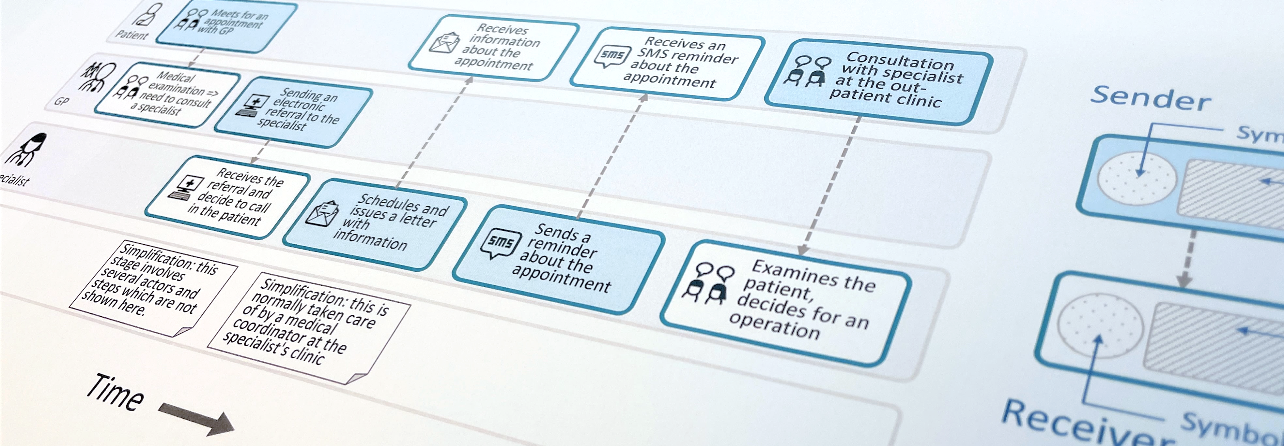
Customer Journey Modeling Language
CJML is a visual language for modeling the journey of an individual, regardless of whether the person has the role of customer, user, employee, patient, or citizen.
CJML consists of terminology, visual notation, a machine-readable data format, methods, and supporting tools.
Customer journey
User journey
Employee journey
Patient journey
Citizen journey
4

Slide 5

Positioning CJML in the journey landscape
Topics in this section:
Services are everywhere
Customer journeys in context
Common challenges in journey mapping
CJML in a nutshell
How CJML extends traditional journey mapping
Core elements
Encoding journeys in xCJML
Scope and limitations

Slide 6

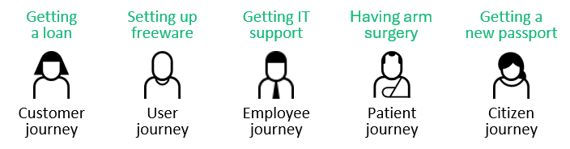
Services are everywhere
Services make up a major part of modern economies and everyday life.
They are provided by companies, public organizations, healthcare providers, and many others.
They unfold as processes over hours, weeks, or even months.
Services are becoming more digital but still involve human interactions.
People’s experience of a service is becoming increasingly important.
Good experiences are a win-win for end users and service providers.
Journeys provide a user-centered lens on experience and service delivery.

Slide 7
About customer journeys
The term customer journey originated in commercial settings but is now used across many service domains.
A customer journey map is a visual representation where touchpoints are arranged along the horizontal axis in chronological order.
The map often includes the end user's experiences and emotions.
Journeys are often divided into before, during, and after the service, although these boundaries may be difficult to define.
Although customer journey mapping is widely used, it has traditionally lacked a formal language and specification.
CJML provides an approach to addressing this gap.
Service domain examples
Hospitality: Going to the cinema. The journey may include booking and paying for a ticket, arriving at the cinema, and watching the movie.
Healthcare: Undergoing knee surgery. The journey may include a GP visit, MRI, specialist consultations, surgery, and follow-up with different healthcare providers.
Introducing CJML
A quick tour of CJML
Theoretical foundation and modeling principles
From scenario to journey

Slide 8
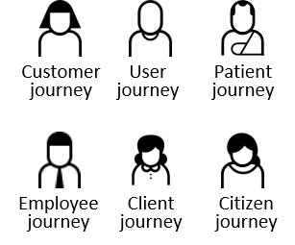
Defining customer journeys
Definition: A customer journey is defined as a sequence or constellation of touchpoints required for a customer to achieve a specific goal or desired outcome.
Customer journey methods and formats vary considerably. Nevertheless, all approaches share three fundamental characteristics:
  The journey is viewed from the end user’s perspective
  The journey unfolds over time as a process
  The journey is divided into steps called touchpoints
The customer journey concept is equally applicable to users,
employees, clients, patients, citizens, and other end users.
A journey may be experience-oriented or mundane, voluntary
or mandatory, and may even lead to an undesirable outcome
(e.g., filing a tax return may result in an additional tax payment)

Slide 9
Common challenges in journey mapping
Journey mapping is widely used, but practices vary considerably. Common challenges include:
Missing or inconsistent definitions
Key concepts such as journey, touchpoint, and actor are often interpreted differently.
Inconsistent levels of abstraction
Some touchpoints represent detailed interactions, while others describe broad journey phases.
Unclear end-user perspective
It is often unclear whether the journey represents a real individual, a persona, an average user, or an idealized scenario.
Ambiguous experience data
When emotions or experiences are shown, it is often unclear whose experiences they represent.
The vertical wild west
The horizontal dimension always represents time. The vertical dimension, however, may represent many different aspects, such as:
😊 Emotions
📱 Channels
💡 Opportunities
👥 Departments
⚙️ Systems
Journey maps are often unique to a particular project or organization, limiting their value beyond their original context.
Key takeaway: Journey mapping should not always be rigid or standardized. Flexibility is often a strength. At the same time, digitalization opens new opportunities for structured journey models that support analysis, interoperability, automation, and AI.

Slide 10
CJML in a nutshell
Traditional journey maps are primarily visual artifacts.
CJML adds the formalism needed to make journey models precise, machine-readable, and suitable for analysis.
Three complementary components form the foundation of CJML.
Machine-readable format
xCJML is an XML-based format for storage, exchange, and interoperability.
Tool support
Provides templates for journey diagrams and data, and tools for creating, visualizing, comparing, and analyzing journey models.
Conceptual metamodel
Defines concepts, properties, and relationships, and provides the basis for the schema definition (XSD) of the data format
Many purposes
CJML goes beyond visualization by enabling systematic journey work.
📖 Journey discovery and documentation: capturing, documenting, and communicating journeys.
🔍 Journey analysis: identifying patterns, deviations, bottlenecks, and opportunities for improvement.
🛠️ Journey design and improvement: supporting service redesign, innovation, and optimization.

Slide 11
How CJML extends traditional journey mapping
CJML extends traditional journey mapping with a more detailed and precise modeling approach. The explicit distinction between planned and actual journeys enables systematic comparison of individual journeys against the planned journey.
Traditional journey mapping
CJML
Tailored to a specific end-user group and service context.
Supports all end-user types and service domains.
Flexible interpretation of touchpoints.
Multiple touchpoint types and categories
A blurred line between theory ("to-be") and reality
("as-is").
Clear separation of planned (to-be) and actual (as-is) journeys
Flexible granularity of touchpoints.
Atomic touchpoints and journey phases for abstraction
Unclear whose experience is represented (persona, average user, idealized user, or real individual).
Experiences are modeled as individual, subjective phenomena at each touchpoint

Slide 12
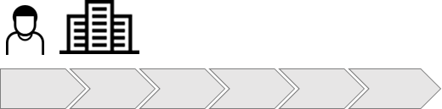
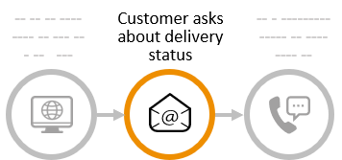
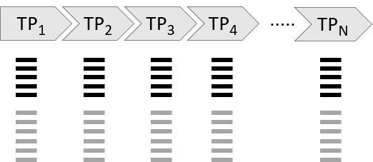
Core elements of CJML
Actors and touchpoints are the central elements of a journey.
A journey consists of a sequence of touchpoints, with at least two required.
A journey must involve at least one end user and one service provider.
Actors
💡
The mandatory attributes appear in the CJML diagram.
Touchpoints
Each touchpoint has a set of attributes.
Some attributes are mandatory, while others are optional.
Mandatory attributes:
Time or order, initiating and receiving actors, and communication channel.
Mandatory attributes:
Time: 11/03/2026, 11:30
Initiator: Customer
Receiver: Company
Channel: e-mail
Text label: “Customer asks about delivery status”
Optional attributes:
Journey phase, message content, associated IT system, etc.

Slide 13

Encoding journeys in xCJML
💡
The example is simplified for readability and illustrates the main principles only. See the Data Format module for the correct syntax.
Journeys can be represented in a structured, machine-readable format called xCJML.
Actors and touchpoints are represented as structured data.
Touchpoint attributes, such as initiator, receiver, and channel, are explicitly encoded.
Journey data can be stored, exchanged, validated, and processed by software.
xCJML is an XML-based data format for representing journeys, defined through an XML Schema Definition (XSD).
<CJML version="3.0">
<actualJourney>
<actors>
<endUser actorID="Customer"/>
<serviceProvider actorID="Retailer"/>
</actors>
<touchpoints>
<touchpoint1>
<initiator> <refersTo actorID="Customer">
<receiver> <refersTo actorID="Retailer">
<label="Customer pays at the cashier"/>
<channel="Face2face"
</touchpoint1>
<touchpoint2>
<initiator> <refersTo actorID="Retailer">
<receiver> <refersTo actorID="Customer">
<label="Cashier provides the receipt"/>
<channel="Face2face"
</touchpoint2>
</actualJourney>
</CJML>

Slide 14

Scope and limitations of CJML
CJML is a conceptual modeling language for representing journeys, supported by a machine-readable data format.
CJML is not an executable process model.
Like many modeling languages, a CJML diagram shows only part of the conceptual model, as many concepts and properties are intended for machine processing rather than visualization.
Additional concepts and properties are defined in the metamodel and machine-readable format.
The available CJML tools have been developed primarily for research purposes. The tools currently support only a subset of the full CJML specification. Support for concepts and features therefore varies between tools.

Slide 15
Customer journey data is inherently fragmented
From simple to complex service delivery
The quest for customer journey data

Slide 16

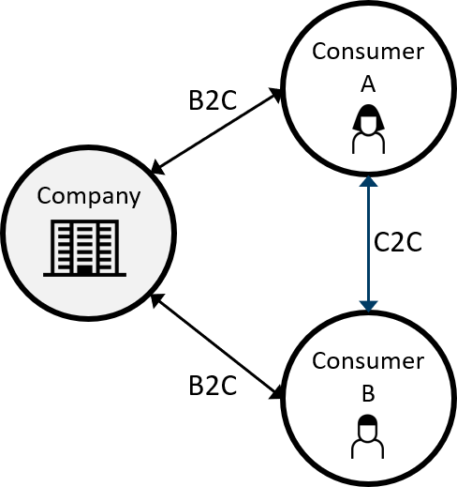
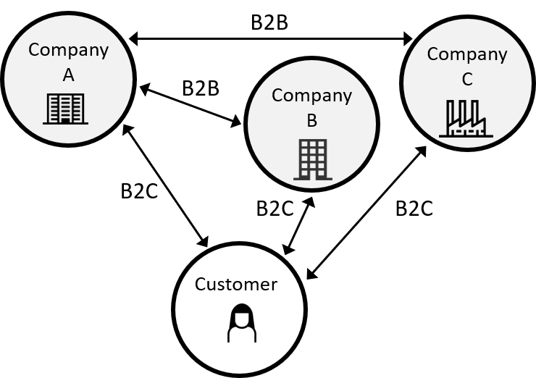
From simple to complex service delivery
The way services are delivered has evolved, giving rise to increasingly complex service delivery models
One-to-one (dyadic) service delivery
Consumer-to-consumer service
Service delivery network
A single service provider delivers a service directly to a single end user. This was the dominant service model in the past. Digitalization, outsourcing, and increasing specialization have given rise to new service delivery models.
Digital platforms enable interactions and value exchange between end users, while coordinating activities such as matching, communication, payment, and trust.
Many services are delivered through networks of collaborating service providers. The end-user journey spans organizational boundaries, requiring coordination across multiple actors.

Slide 17
The quest for customer journey data (I)
Modern services are often delivered through networks of collaborating organizations rather than by a single provider.
When a service is executed, an actual journey emerges as the customer interacts with multiple organizations, departments, channels, and IT systems
These interactions leave behind digital traces that may provide insight into the actual journey.
Different actors may be responsible for different parts of the journey.
Journey data is distributed across organizational and technical boundaries.
Reconstructing the complete journey therefore becomes highly challenging.
Lost between silos
The end-to-end journey perspective is often lost as services cross organizational boundaries. An empirical study identified several recurring challenges:
🚨 No one had responsibility for the end-to-end journey.
🚨 Unknown touchpoints existed in the planned service.
🚨 Departments understood only their own part of the process.
🚨 Major coordination gaps existed between organizational silos.
Halvorsrud, R., Kvale, K., & Følstad, A. (2016). Improving service quality through customer journey analysis. Journal of Service Theory and Practice, 26(6), 840-867.

Slide 18
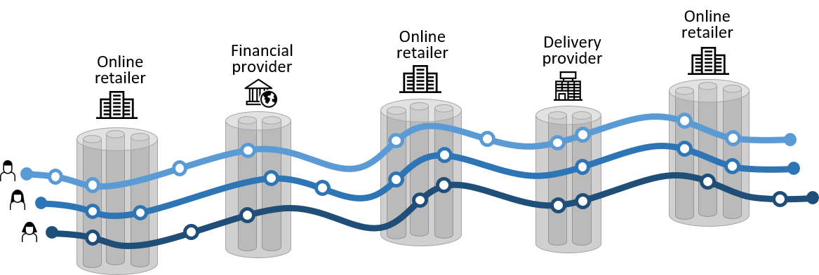
The quest for customer journey data (II)
The following example illustrates the challenge of capturing customer journey data in a typical online retail service.
The retailer is the main service provider, supported by two service partners: a payment provider and a logistics provider.
Three customers follow unique journeys, interacting with all three service providers.
Each customer journey also intersects several IT systems within each service provider.
Each service provider records only the touchpoints captured by its own IT systems.
💡
Even when data is available across systems and service providers, turning it into a coherent view of the customer journey is not straightforward.
Some touchpoints are not traceable, such as face-to-face interactions at a service desk.

Slide 19
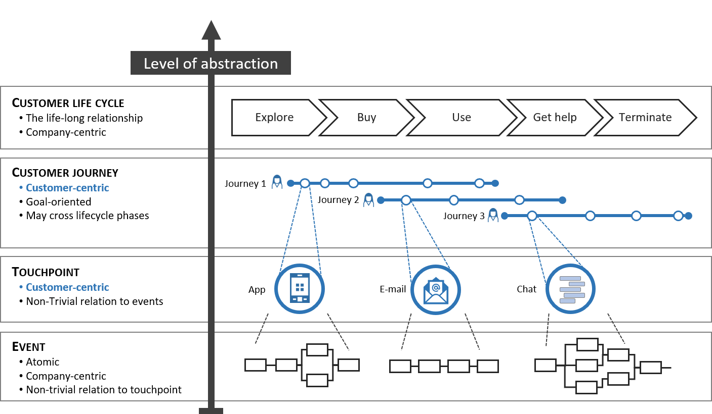
The quest for customer journey data (III)
Customer-related information exists at different levels of abstraction, from the customer lifecycle down to low-level events recorded by information systems.
Journeys and touchpoints sit in between two levels that are often company-centric.
Linking events to customer touchpoints is not straightforward:
  Customer data comes from different systems and service providers, requiring substantial cleaning, filtering, alignment, and integration.
  Matching the same end user across systems can be restricted by privacy requirements.
  Many events may lie behind a single touchpoint, making the mapping non-trivial.
💡
These papers explore how event data can be linked to customer journeys.
Brekke, Halvorsrud, Mannhardt, Brurok, Meironas (2025)
Connecting the Digital Dots - Can Customer Journeys Be Analyzed Purely from Event Logs?
Workshop paper at BPM’2025. DOI and author version.
Mannhardt, Halvorsrud, Meironas, Brurok (2024).
The quest for the comprehensive customer journey - A case study from a C2C marketplace.
Paper at the conference BPM’2024. DOI and author version.
Halvorsrud, Mannhardt, Prillard, Boletsis (2024).
Customer journeys and process mining–challenges and opportunities.
Open access paper, IESS’2024 Int. Conf. on Exploring Service Science.

Slide 20
Journey analysis and use cases
Different ways to analyze journeys
Use case matrix

Slide 21
Different ways to analyze journeys
Journey models can be used in different ways, and the analytical perspective depends on the use case.
The planned journey helps us understand how a service process is intended to unfold.
The actual journey helps us understand what actually happens in practice, and how it is experienced from the user’s perspective.
In many cases, it is useful to study both to compare intention and reality, identify deviations, and discover opportunities for improvement.
The perspective also depends on where you are in the service innovation process, for example whether you are designing a new service or studying an existing one. This, in turn, affects what journey data is available.
Focus on planned journey
Focus on both
Focus on actual journey
Theory
Assumption
Process model
To-be
Deviation
Compliance
Improvement
Reality
Execution
Process data
As-is

Slide 22
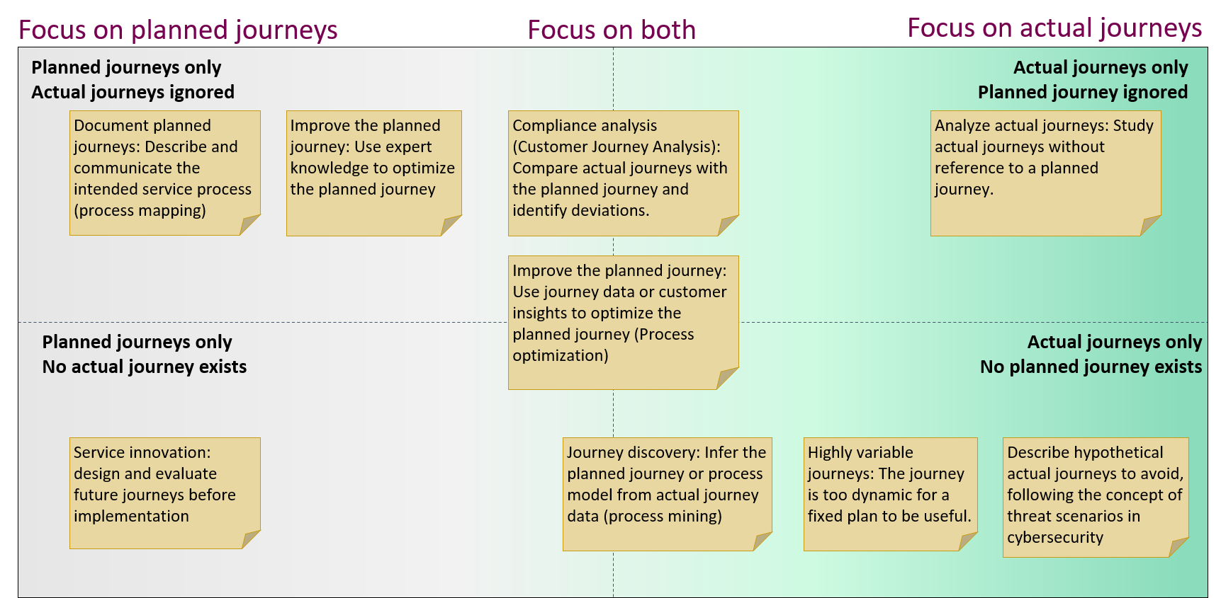
Use case matrix
The matrix shows different approaches to journey analysis, depending on whether the focus is on planned journeys, actual journeys, or both.

Slide 23
How to get started?
Things to consider
Granularity: From vague to detailed model
Flexibility: Freedom versus standardization
Automation: Manual work versus automation
Overview of tools

Slide 24
Working with journeys
💡
Check out the overview of Tools at the end of this section.
As seen in the previous section, there are many starting points for journey work, depending on your goals and the information or data available.
There are three dimensions that are useful to consider:
  Granularity: Vague description versus detailed model
  Flexibility: Visual freedom versus standardization
  Automation: Manual work versus automation
Journey work can start anywhere along these dimensions and move in either direction.
CJML provides different tools that can support journey work at different points along these dimensions
An overview of the CJML tools is provided in the end of this section

Slide 25
Granularity: From vague to detailed model
Journey work can start at any level of detail.
The appropriate level depends on the purpose and the information available.
A journey can be gradually refined as more information becomes available.
I have a detailed description of all actors and touchpoints in the journey
I have a mental model of how the journey unfolds
I know the main steps of the journey
I have identified the key actors and touchpoints
I have a formally specified journey model (xCJML).
Vague description
Detailed model
⚙️Pen and paper/whiteboard →
⚙️CJML editor →
⚙️Diagram templates →
⚙️Template for journey data →

Slide 26
Flexibility: Freedom versus standardization
Creative design processes often require freedom to adapt and stretch the CJML notation.
At the other end, standardization makes models consistent and easier to compare.
How much freedom or standardization you need depends on what you want to achieve.
I can freely adapt the visual representation
I follow CJML but extend the notation when needed
I follow the CJML visual notation
The notation is enforced by the tool
Visual freedom
Visual standardization
⚙️Pen and paper/whiteboard →
⚙️Diagram templates →
⚙️CJML editor →

Slide 27
Automation: Manual work versus automation
Journey models can be created manually, generated from data, or developed through a combination of both.
The degree of automation depends on the available data and the purpose of the journey work.
I draw the journey by hand
I adapt a journey template
I adapt a template for journey data
The journey is generated from available data
Manual work
Automated modeling
⚙️Pen and paper/whiteboard
⚙️Diagram templates
⚙️CJML editor (canvas)
⚙️CJML data template
⚙️CJML editor (import xCJML)
⚙️CJML converter

Slide 28
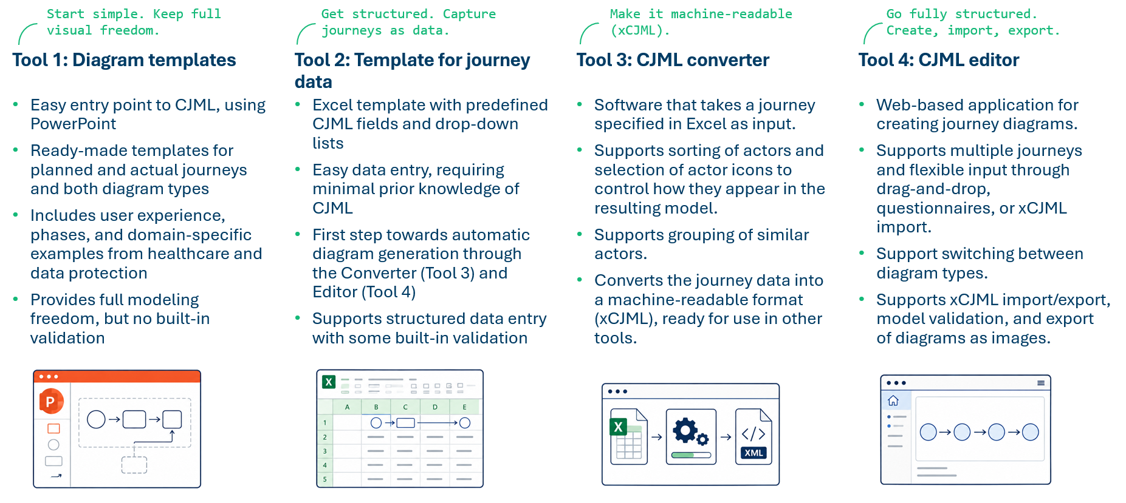
Overview of tools
💡
Check out the Tools module to access the tools and learn more about them.

Slide 29
Tips and tricks
Granularity and precision
Distinguishing actions and communication points

Slide 30
Granularity and precision
💡
CJML supports abstraction through journey phases, for example: before the journey, during the journey, and after the journey. More information can be found in the Terminology and Visual Notation modules.
Service processes consist of activities that can be broken down into increasingly detailed steps, making it necessary to decide which steps should be represented in the model.
The general rule is to divide the process into touchpoints representing the smallest meaningful unit of content, taking the purpose of the modeling into account.
A new touchpoint is created whenever one of the following attributes changes:
  The actor changes (for example, in air travel, when moving from the check-in desk to the security check, a new person approaches the traveler)
  The communication channel changes (or the device used by the end user)
  The direction of the message flow changes
Modeling always involves simplification. For example, a phone call involves many detailed steps that are normally irrelevant to the model, such as holding the phone to the ear.
The appropriate granularity depends on the purpose of the analysis. Dialing a telephone number may normally be omitted but could be essential when analyzing an emergency service.
How much detail? In an end-to-end analysis of an online shopping experience, every click does not need to be modeled as a separate touchpoint. For example, many individual clicks may be grouped into broader touchpoints such as browsing, adding to cart, and completing the order. In a conversion analysis, however, the detailed click path may be the main focus.
Relevance depends on the analysis:
A visit to the doctor involves many actions. Which ones should be modeled depends on the purpose of the analysis.
Often included:
Making the appointment
The doctor's examination and outcome
Sometimes relevant:
Registration upon arrival
Payment
Usually omitted:
Transportation to the doctor’s office
Opening the door to the doctor’s office

Slide 31
Distinguishing actions and communication points
Distinguishing communication points and actions can sometimes be difficult if one does not have definitions and guidelines to refer to.
Communication, as defined in CJML, requires that an actor sends a message to an intended receiver in the context of the journey. Consequently, a radio broadcast or an advertisement on a bus is not considered a communication point but an action.
Note that merely receiving or perceiving information is not considered communication in CJML. Communication requires that an actor sends a message to an intended receiver in the context of a journey.
Example 1: John reads and signs a printed contract.
  This step is an action because it does not involve communication.
Example 2: John scans the signed contract.
  This step is also an action because no message is sent to another actor.
Example 3: John emails the scanned contract to the insurance company.
  This step is a communication point because a message is sent to an intended receiver.
Examples of communication points
A patient has a telephone conversation with the doctor.
The doctor receives an epicrisis from the specialist.
A patient receives an SMS reminder about the upcoming appointment with the doctor.
Examples of actions
Writing down questions before a visit to the doctor.
Reading an information brochure at the doctor's waiting room.
Looking at the map of the hospital area to find the right building.

Slide 32
From scenario to journey
① Define the journey context
② Outline the journey
③ Identify the touchpoints
④ Connect the touchpoints
⑤ Choose the appropriate diagram

Slide 33
Five steps to a journey model
A CJML journey model can be developed from different types of input, including
  mental model or textual scenario
  domain knowledge
  stakeholder input
  empirical journey data
  or a combination of these.
The five-step process presented here provides a systematic approach to transforming these inputs into a consistent and useful journey model.
Detailed guidance for each step is provided in the following slides, followed by an illustrative example.
Note that this five-step process is an adaptation of the first two phases of the Customer Journey Analysis (CJA) method. See the reference for further details and an illustrative example.
1. Define the journey context
2. Outline the journey
5. Choose the appropriate diagram
4. Connect the touchpoints
3. Identify the touchpoints
Halvorsrud & Kvale, K. (2017). Strengthening customer relationships through customer journey analysis. In Innovating for trust (pp. 183-200). Edward Elgar Publishing. DOI and author version

Slide 34
Step 1: Define the journey context
🎯 Prepare for modeling.
  Clarify what questions the journey model should help answer and what information or data is available.
  Identify the organizations, departments, or roles that should be consulted
  during the modeling process.
🧑 Identify the primary end user.
  Customer, patient, employee, citizen, etc.
  What is the end user trying to achieve?
🏢 Identify the actors involved.
  Identify the primary service provider.
  Identify supporting organizations, people, and digital systems.
📋 Determine the journey type.
  Planned or actual? Or both?
✂️ Define the scope.
  Where does the journey start and end?
  Choose a scope that supports the purpose of the model.
💡
Start with a high-level outline
Focus on the big picture first and refine the model gradually
A rough sketch on paper or a whiteboard is often a good starting point, as it is easy to modify and refine.
A variety of journey model templates can be found in the Template module. These can be adapted as the model evolves.

Slide 35
Step 2: Outline the journey
💡
Review relevant internal processes to understand what happens behind the scenes.
If many variants exist, focus on a representative journey. Capture the most typical path first.
Keep the journey anchored in the end user's perspective throughout the modeling process. Avoid drifting into an organizational or process-centric perspective.
🔍 Familiarize yourself with the service.
  Walk through the journey yourself if possible.
  Review any end-user-facing material.
🧭 How does the journey unfold over time?
  Think in chronological order.
  Does the end user interact continuously or only at specific points?
  Identify potential pauses, waiting periods, or repeated cycles.
🚩 Identify the major phases or milestones.
  Break the timeline into meaningful sections.
  Use phases to provide structure before adding touchpoints.
✂️ Refine scope if needed.
  Does the proposed timeline still have a meaningful start and end?
🔄 How do the actors communicate?
  Is the journey primarily digital, physical, or a combination of both?
  Where do actors exchange information or hand over responsibility?

Slide 36
Step 3: Identify the touchpoints
💡
Look for missing touchpoints. Even simple notifications and confirmations are part of the journey.
🔍 Identify the key interactions.
  Focus on interactions between actors.
  Consider both digital and physical interactions.
💬 Describe the communication points.
  Who initiates it? Who receives it?
  Which communication channel is used (app, website, email, phone, etc.)?
🛠️ Identify relevant actions.
  Include important non-communicating actions.
⚛️ Keep each touchpoint atomic.
  Split broad or combined descriptions into separate touchpoints.
✅ Check that all touchpoints are covered.
  Walk through the journey from the end-user perspective.
  Check documentation and look especially for confirmations, notifications, handovers, and follow-up interactions that are easy to overlook.

Slide 37
Step 4: Connect the touchpoints
🔗 Connect related touchpoints.
  Show how one interaction or action leads to the next.
  Include handovers between actors where relevant.
🕒 Arrange the touchpoints over time.
  Place them in chronological order.
  Consider pauses, waiting periods, repetitions, or parallel activities where needed.
🧭 Check the overall flow.
  Does the journey make sense from start to finish?
  Are there gaps or unexplained transitions?
📝 Document uncertainties and assumptions.
  Add comments where information is incomplete or uncertain.
  Distinguish confirmed information from assumptions.
✅ Review the journey with others.
  Review relevant parts with stakeholders.
  Revise the model based on feedback or when new information appears.

Slide 38
Step 5: Choose the appropriate diagram
🎯 Consider the purpose of the diagram.
  Choose the diagram that best communicates the aspects you want to emphasize.
  Review the Visual Notation module for examples and special features you may need.
  Split large journeys into multiple diagrams if needed.
  Use the annotation and comments swimlanes to document assumptions, uncertainties, and supplementary information.
📊 Select the diagram type.
  Use a journey network diagram when many actors interact.
  Use a customer journey diagram when focusing on a specific case or an actual journey with deviations.
🎨 Apply the visual notation consistently.
  Use the Templates module to create the final diagram efficiently.
💡
Check out the Tools module. A Journey Editor is available, although it offers less flexibility than general-purpose drawing tools.
Alternatively, use the Excel template to specify the journey, convert it to xCJML, and import it into the CJML Editor.

